Slide 1

Robo Advisory in India: Strategic Overview

Slide 2

Presentation Agenda
Industry Review
India vs. USA
CEO Strategy
Current state of Indian robo-advisory, adoption drivers, and the 2025 regulatory landscape.
A comparative analysis of market structure, consumer behavior, and fee models.
A forward-looking roadmap focusing on "Bionic Advisory", HNI growth, and technology.
2

Slide 3
How Robo-Advisors Have Performed in India So Far
Market Metrics
Robo-advisory is still a young and developing sector in India compared to mature markets.
Growing interest among younger, tech-savvy investors, mainly due to low cost and ease of use.
Around 39 robo-advisory firms currently operate in India (Tracxn, data analytics source).
Funding traction has increased: about 10 out of 39 firms have received investments.
FundsIndia.com: One of the earliest robo-advisory platforms; raised $15.41 million from major investors such as Foundation Capital, Inventus Capital, and Faering Capital.
3

Slide 4
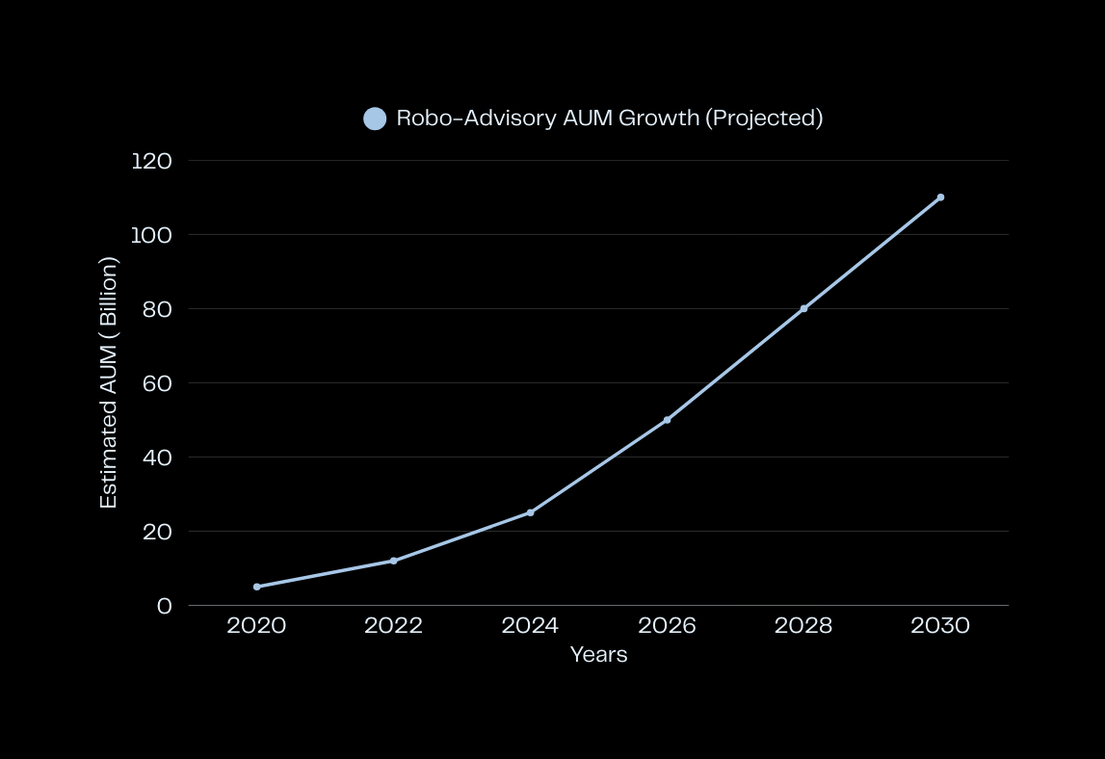
AUM Growth Overview
Projected trends in Assets Under Management for Indian robo-advisors
The robo-advisory market in India is expected to see substantial growth, driven by increasing digital adoption and investor awareness.
4

Slide 5
Different Models
Robo-advisors in India mainly offer mutual fund-based portfolios (equity + debt).
Advisory-fee model: Platform charges an advisory or convenience fee; you invest through them.
Distribution model: Advisory is free; platforms earn commission from mutual fund houses (regular plans only).
Mixed model: Platforms charge advisory fees but waive them if you invest through their commission-based channel.
Direct plan investing is usually not integrated; users must do it independently if they want zero-commission investing.
Example: FundsIndia recommends funds for free but only for regular plans; direct plans must be executed outside the platform.
Some platforms (e.g., Arthayantra) charge a yearly advisory fee but offer free advice if the user invests through their regular-plan route.
Some services (e.g., BigDecisions) are not full robo-advisors; they only offer goal calculators and redirect users to investment platforms.
Different robo-advisors offer different fund universes: Some (e.g., Scripbox) use a limited, pre-selected fund list chosen by algorithms/experts. Others provide a wider range including gold ETFs, bonds, and tax-saving instruments.
A few platforms help keep funds in cash or liquid funds depending on market conditions.
5

Slide 6



Key Indian Platforms
Groww
Kuvera
Scripbox
A user-friendly platform for seamless investment management.
Focused on goal planning with no commission fees.
Simplifying investments through personalized recommendations.
6

Slide 7

India vs U.S.
Comparing Robo-Advisory Experiences
7

Slide 8
Aspect | India | USA
Level of Automation | Not fully automated; user must manually initiate transactions. No autopilot investing. | Fully automated; funds are selected, invested, and rebalanced automatically without user intervention.
Primary Investment Products | Mostly actively managed mutual funds; ETFs still in early adoption. | Primarily ETFs (passive index funds), forming the core of robo portfolios.
Fee Structure | Usually flat fees, low fixed charges, or free advisory; often commission-based models. | Fees based on percentage of assets under management (AUM); e.g., Betterment 0.15–0.35%, Wealthfront 0.25%.
Investor Behaviour | Investors are not used to paying advisory fees; advisors often earn commissions → potential conflict of interest. | Investors are accustomed to paying for advisory services; fee-based model widely accepted.
Cost Positioning | Aims to increase penetration with low-cost or free advice but still tied to commission structures. | Offers very low-cost, transparent, commission-free investing via ETFs, focusing on affordability and scale.
Tax-Loss Harvesting | Not a major feature; tax optimization via automation is minimal. | Tax-loss harvesting is a key feature to reduce tax burden and improve post-tax returns.
8

Slide 9
Why these gaps?
Awareness: One of the biggest problems is a lack of awareness about these platforms in India. Even after investing in advertisements and other paid marketing tactics, the awareness of mutual funds is very low.
Complicated: Despite claims made by robo-advisors that they have simplified investment processes, they are far behind in what can be done to attract new investors.
9

Slide 10
CEO Roadmap
Bionic Model
Implementing a bionic model that integrates technology with human advisors will enhance client engagement, offering personalized services while maintaining operational efficiency in robo-advisory solutions.
Build Trust
Establishing a trust-first approach through transparency in operations and robust compliance measures will enhance client confidence, ensuring a sustainable growth trajectory for robo-advisory services in India.
Target Markets
Focusing on both retail clients and high-net-worth individuals (HNIs) enables a diversified client base, allowing firms to leverage different strategies tailored to varying financial needs and expectations.
10

Slide 11
Growth Strategies for Success
Retail SIPs
Implementing retail robo Systematic Investment Plans (SIPs) will engage customers by offering affordable, user-friendly investment options, catering to a broader market and enhancing financial inclusion.
Premium Advisory
Targeting high-net-worth individuals through premium advisory services will ensure tailored solutions that meet specific investment goals, fostering deeper relationships and increased revenue potential for the advisory firms.
Strategic Partnerships
Forming partnerships with banks and non-resident Indians (NRI) will expand market reach, leverage existing customer bases, and enhance brand credibility within the competitive landscape of robo-advisory services.
Pricing Experiments
Conducting pricing model experiments will allow firms to identify optimal structures that balance profitability and customer acquisition, adapting to market dynamics and fostering long-term growth for the industry.
11

Slide 12
Tech & Product Evolution
Risk Scoring
Implementing advanced risk-scoring models powered by machine learning enhances client assessment, allowing robo-advisors to tailor investment strategies based on individual user profiles and risk appetites effectively.
ModelOps
Adopting ModelOps and continuous integration/continuous delivery (CI/CD) frameworks streamlines enhancements in robo-advisory platforms, ensuring rapid deployment of innovative features while maintaining high standards of quality and reliability.
Composable APIs
Utilizing composable APIs fosters seamless integration of third-party services, enabling robo-advisors to enhance their offerings, improve user experience, and support customized financial solutions for diverse client needs.
Future Readiness
Focusing on future readiness is crucial for robo-advisors; investing in adaptive technologies and keeping abreast of regulatory changes ensures sustained growth in an evolving fintech landscape and competitive market.
12

Slide 13
Regulatory Compliance
Model Disclosures
Ensuring clear model disclosures is vital for building client trust. Transparency about strategies, fees, and risks will enhance credibility and compliance with regulatory requirements in the robo-advisory industry.
Complaints Dashboard
A monthly complaints dashboard serves as an essential tool for monitoring client feedback and resolving issues promptly. This proactive approach aids in maintaining a positive relationship with customers and regulators.
Legal Checks
Implementing pre-launch legal checks is crucial to mitigate risks associated with compliance. These assessments ensure that all advisory services align with current regulations before being introduced to the market.
Regulatory Readiness
Establishing a framework for regulatory readiness helps firms adapt to evolving regulatory landscapes. This proactive stance ensures that robo-advisors remain compliant and competitive in an increasingly scrutinized industry.
13

Slide 14
International Opportunities
NRI Portfolios
Developing tailored investment portfolios for Non-Resident Indians (NRIs) can enhance engagement and satisfaction, addressing unique financial needs and preferences while capitalizing on cross-border investment trends.
Global ETFs
Introducing global Exchange-Traded Funds (ETFs) can diversify investment options, providing access to international markets while optimizing tax efficiencies through strategically designed wrappers for Indian investors.
Cross-Border KYC
Implementing cross-border Know Your Customer (KYC) processes will streamline client onboarding, ensuring compliance and facilitating smoother transactions for NRIs, which can enhance the overall user experience.
Market Expansion
Exploring potential for market expansion in Southeast Asia can leverage India's established fintech capabilities, tapping into a growing market of tech-savvy investors seeking innovative financial solutions.
14

Slide 15
Implementation Roadmap
Q1
Q2
Q3
Q4
Audit and pricing A/B tests will refine our service offerings.
Pilot the HNI prototype to assess market response and gather insights.
Introduce global ETFs to broaden investment options for our clients.
Scale NRI and bank leads to enhance our customer base and reach.
15

Slide 16

Key Performance Indicators
Tracking essential metrics to ensure growth and success in the robo-advisory sector.
Regularly analyzing AUM growth, customer acquisition costs, and net promoter scores is vital for strategic decision-making.
Monitoring user retention, churn, and conversion rates helps assess platform growth and stability. Evaluating portfolio performance against benchmarks, along with ARPU(average revenue per user) and lifetime value, provides insight into profitability. Measuring the accuracy of automated recommendations ensures trust and long-term effectiveness.
16

Slide 17
Conclusion
Robo-advisory in India is still evolving but shows strong potential, driven by growing digital adoption, low-cost investment needs, and rising interest among young investors. While the sector differs from the mature U.S. market in automation, fee models, and product structures, Indian firms continue to innovate within local constraints. With supportive regulation, improved automation, and strategic use of technology, robo-advisors in India can scale rapidly and tap into both domestic and global opportunities.
17

